Slide 1
Self Care plan
tada

Slide 2
Self-care with List
Walk in the morning w/no distractions phone, etc
Snuggle with Chihuahua (Rocky!)
Podcast on meditation
Visit relatives
Meetup with friends
Learn something technical or softskills
Take breaks thru out day

Slide 3
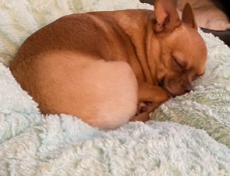
Picture of Rocky Sleeping makes me so happy!
awwwwwwe

Slide 4
Well-Balanced
Walking Rocky consistently
Meditation consistently
Social consistently
Learn something…
Music –C89.5
Goals…
Physical | Spirtual | Social | Learn
Dog park | Meditation | Meetup | IT
hiking | Podcasts | Dinner | ITSecure
Adventure | Church | Relatives | LifeStuff

Slide 5


Affirmations Slides
You can do it!
Be good to yourself!

Slide 6



Adventures!
Adventures
Experience new things
love

Slide 7
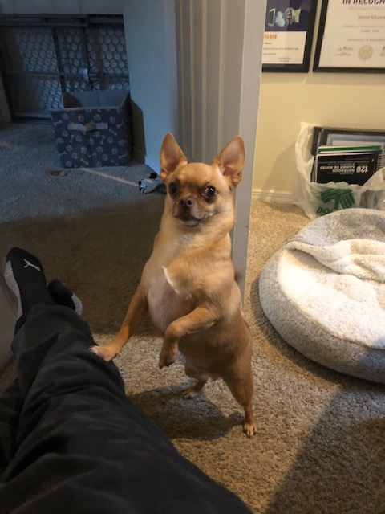
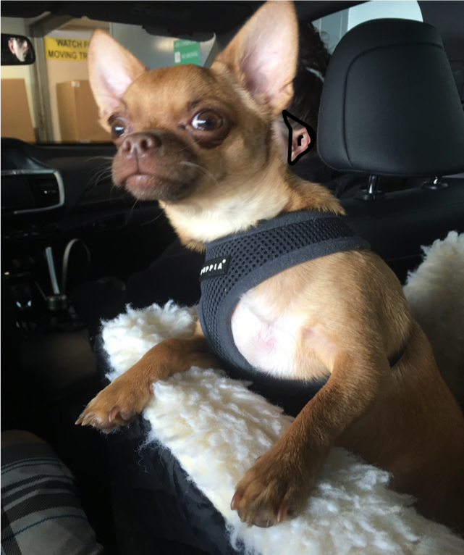
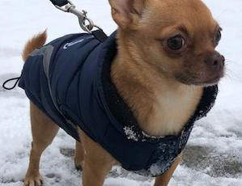
ROCKY!!!
☺

Slide 8
Pet Plan? Or Self Care Plan? You decide!
…

Slide 9
What if I knew I could do anything?
Dream big
What is your dream

Slide 10
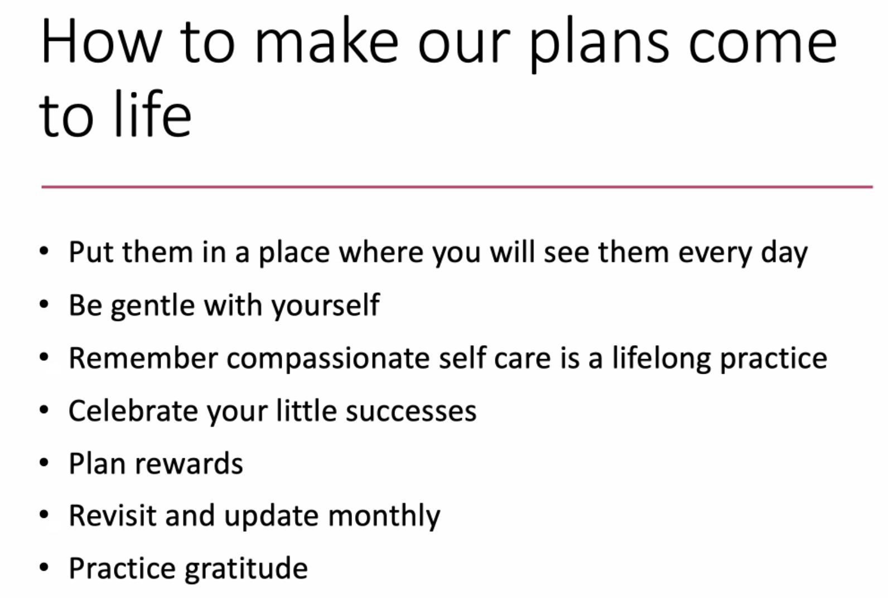
Add a Slide Title - 6

